Slide 1
TASK RUNNERS
By: Reginn Lloyd Singgo

Slide 2


WHAT’S A TASK RUNNER?

Slide 3
A TASK RUNNER IS A TOOL USED TO AUTOMATE TASKS IN THE DEVELOPMENT PROCESS.
THE TASK CAN BE USED TO PERFORM A WIDE VARIETY OF OPERATIONS SUCH AS THE COMPILATION OF TYPESCRIPT FILES OR THE COMPRESSION OF JAVASCRIPT FILES.
THE TWO MOST POPULAR JAVASCRIPT TASK RUNNERS THESE DAYS ARE GRUNT AND GULP.
001
002

Slide 4
ALTEZZA
What are the common tasks?
The Common Tasks are…
Minifications of scripts and styles
Concatenation
Cache Busing
Testing, linting, and optimization
Dev Servers
CLICK TO CONTINUE
Notes:
Concatenation, is the operation of joining two strings together. The term"concatenation" literally means to merge two things together. Also known as string concatenation. concatenation can be applied to any other data type, including objects. For simple data types such as binary, integer, floating point, character and Boolean, prior to concatenation string type conversion is applied.
Cache busing updates the browser that there will be a new version of a cache file inserted/

Slide 5

GULP
Basically, you use Gulp to automate stuff that you would normally have to do manually, such as manually compiling Sass, manually optimizing images, manually refreshing your page in the browser, and so on.
Well, these three actions can be consolidated into independent tasks. Then you would take those tasks and have Gulp run them automatically. That's why tools like Gulp and Grunt are called task runners.

Slide 6

GRUNT
Grunt is a JavaScript task runner, a tool used to automatically perform frequent tasks such as minification, compilation, unit testing, and linting. It uses a command-line interface to run custom tasks defined in a file (known as a Gruntfile). Grunt was created by Ben Alman and is written in Node.js. It is distributed via npm. As of September 2016, there were more than 5,000 plugins available in the Grunt ecosystem.
Companies that use Grunt include Adobe Systems, jQuery, Twitter, Mozilla, Bootstrap, Cloudant, Opera, WordPress, Walmart, and Microsoft.

Slide 7
ALTEZZA
More Slides here!
www.yourcompany.com
THE
DIFFERENCE?
The Difference are…
Gulp and Grunt are task runners. They are different approaches to same problem. Grunt uses configuration based approach, while Gulp uses streams from node to achieve result. You use them to define how and which tasks to execute (copying files, adding banners, replacing text, style checking). They ran from command line, manually.
CLICK TO CONTINUE

Slide 8
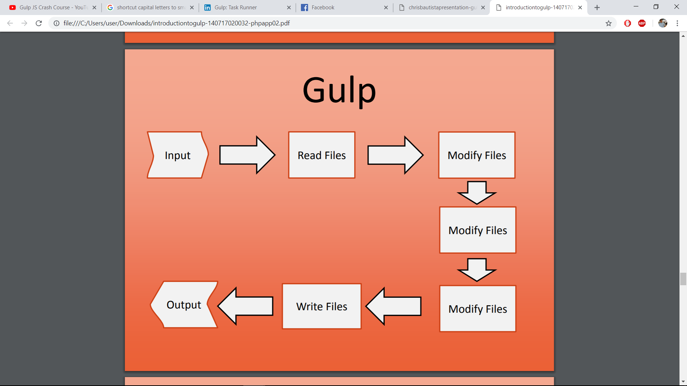
ALTEZZA
More Slides here!
www.yourcompany.com
Shown below are the build system workflow of Gulp and Grunt. Gulp uses Streams of Node.js enabling an easier use, while Grunt has many processes before having an output.
CLICK TO CONTINUE

Slide 9
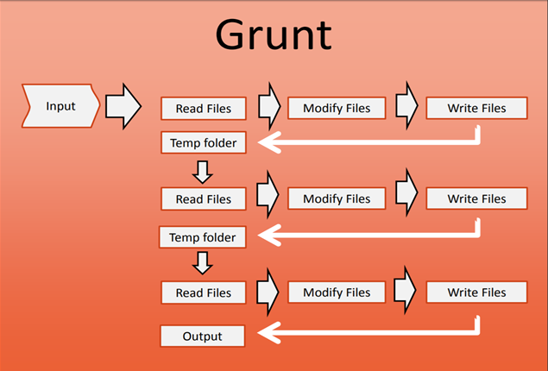
ALTEZZA
More Slides here!
www.yourcompany.com
Shown below are the build system workflow of Gulp and Grunt. Gulp uses Streams of Node.js enabling an easier use, while Grunt has many processes before having an output.
CLICK TO CONTINUE

Slide 10
DEMO
Here we are going to demonstrate how to use task runners. In this demo I will be using Gulp

Slide 11
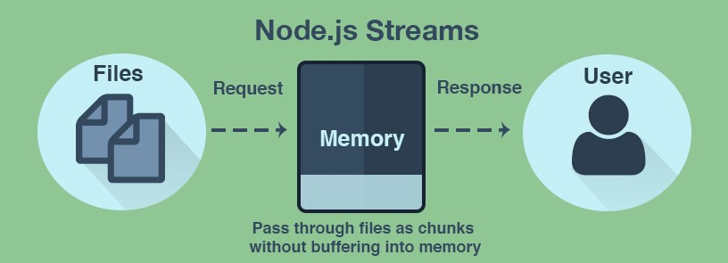
ALTEZZA
BUT BEFORE THAT…
Let’S first explore how Gulp works
Gulp builds on node streams
Pipeline / .pipe operator
Single Purpose plug in
Files are not affected until all plug ins are processed
Notes:
Node Streams is a continuous flows of data that can be manipulated asynchronously
-Example one plug in can minify javascript files and will be piped and compile for example a SASS files into a CSS

Slide 12
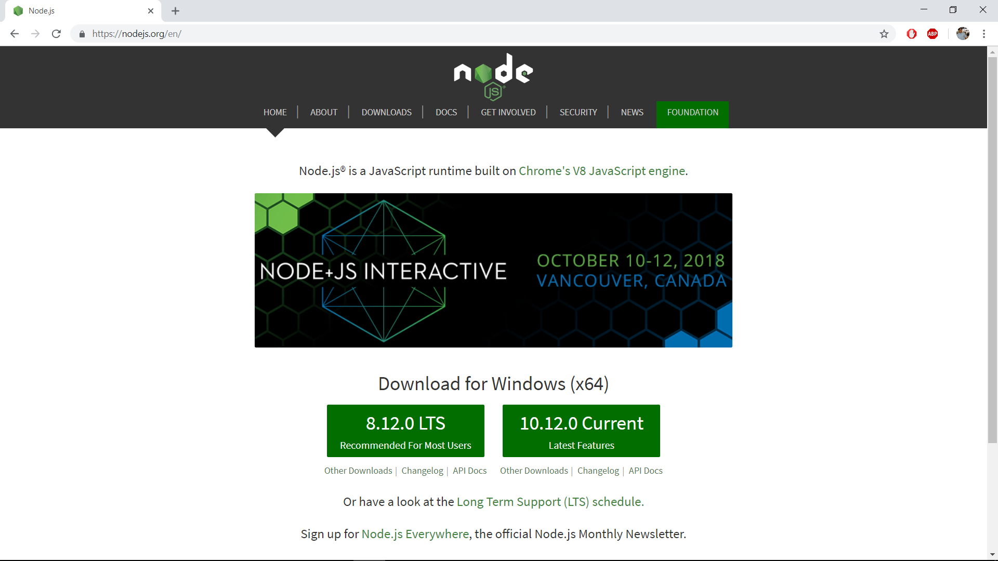
NOW ONTO THE DEMO…
Before we go to Gulp. Download Node.js from Nodejs.org. After the download, install.

Slide 13
---- install
> npm install -g gulp
> npm init
> npm install gulp --save-dev
----- configure
> nano gulpfile.js
----- run
> gulp
NEXT, DO THE FOLLOWING ON THE COMMAND LINE…
The following are commands for installing, configuring, and running Gulp. You may do this on Git, CMDer, or on your basic command prompt.

Slide 14
gulp.task('js', function () {
...
});
gulp.task('css', function () {
...
});
gulp.task('server', function () {
...
pipe(livereload());//browser reload
});
gulp.task('default', function () {
...
Tasks
After you have installed Gulp, we need to ensure that Gulp has its tasks entered. Running tasks is the main objective of Gulp and Grunt.

Slide 15
webapp/
├── build
│ ├── images
│ ├── css
│ └── js
│ └── vendor
├── node_modules
│ ├── gulp
│ ├── gulp-concat
│ ├── gulp-html-replace
│ ├── gulp-notify
│ ├── gulp-uglify
│ └── gulp-uglifycss
├── src
│ ├── images
│ ├── css
│ └── js
│ └── vendor
├── package.json
Source and Destination
Picture shown on the right is the following sources and destination where you want to save your codes, image, css, javascripts, and to properly organize gulp plugins to avoid inorganized work.

Slide 16
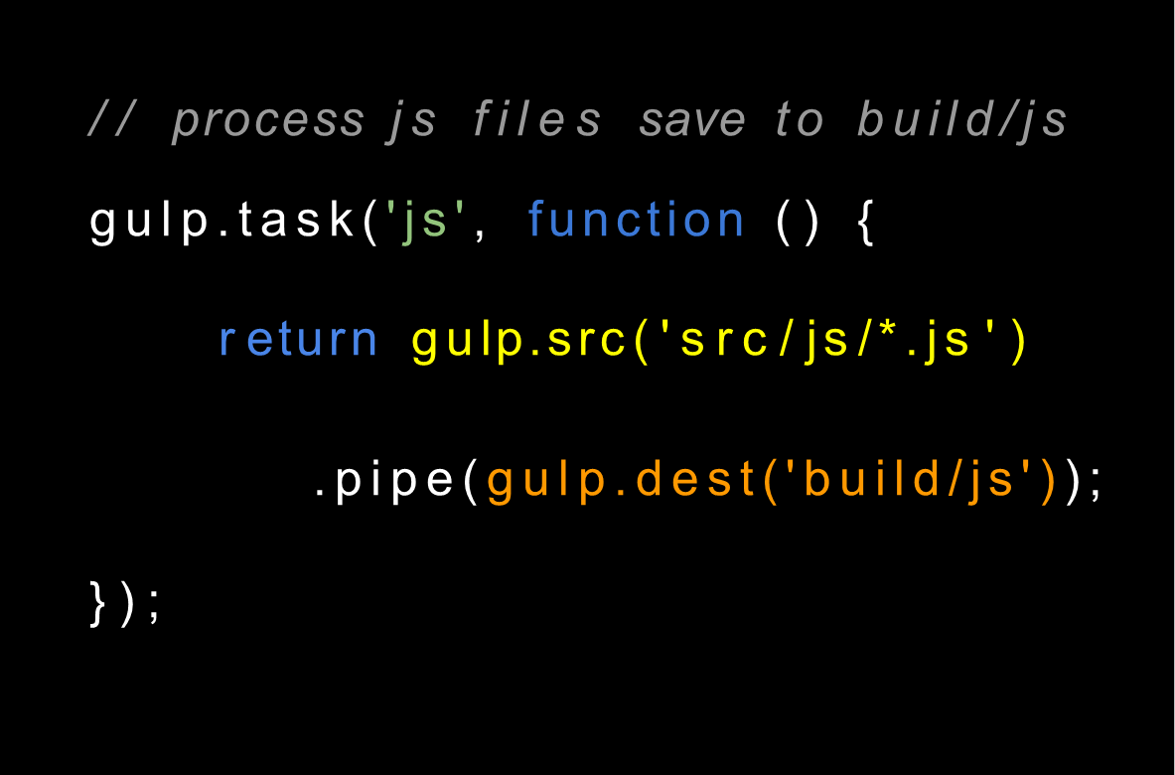
Source and Destination
Picture shown on the right is the processing of javascript files in order to put it to build/js

Slide 17
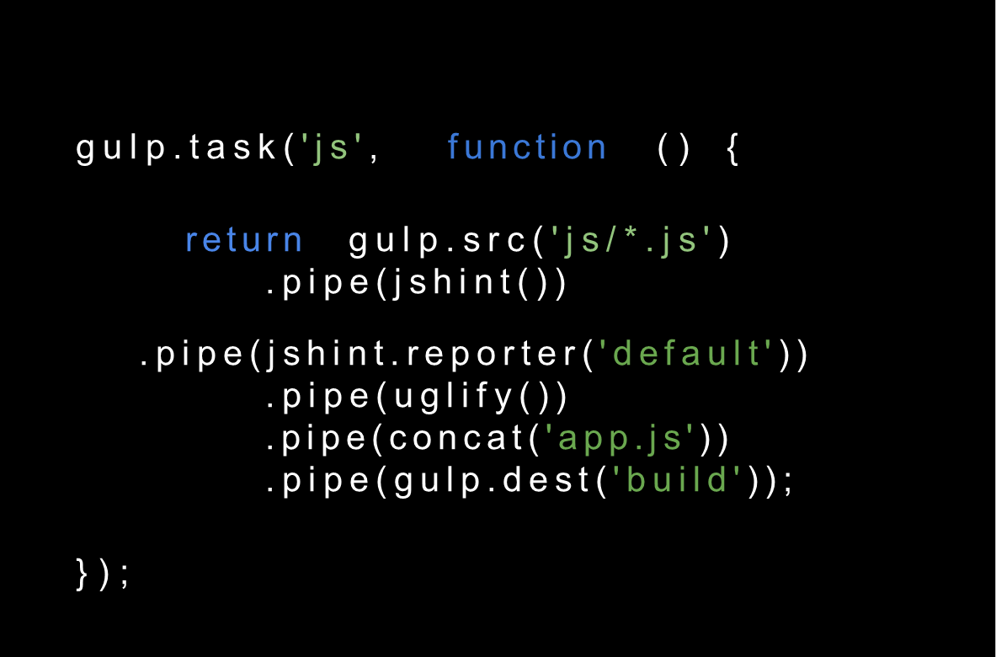
Streams and Pipe
Streams are unix pipes that let you easily read data from a source and pipe it to a destination. Simply put, a stream is nothing but an EventEmitter and implements some specials methods. Depending on the methods implemented, a streambecomes Readable, Writable, or Duplex (both readable and writable).

Slide 18
gulp.task('setupJSWatch', function () {
gulp.watch('js/*.js', ['build']);
});
gulp.task('build', function () {
...
});
Watch
The Watch method is used to monitor your source files. When any changes to the source file is made, the watch will run an appropriate task. You can use the 'default' task to watch for changes to HTML, CSS, and JavaScript files.

Slide 19
NOW ONTO THE PLUGINS
There are tons of plugins available for Grunt and Gulp, but since Grunt existed before Gulp, Grunt has over 2,580 Plugins while Gulp has only 432 as of 2014 (http://www.oomphinc.com/blog/2014-
03/gulp-vs-grunt-node-js-automation-toolsshowdown/)

Slide 20
----- add plugins
> npm install gulp-[plugin] --save-dev
...
"devDependencies": { "gulp-concat": "^2.3.3",
"gulp-jshint": "^1.7.1",
"gulp-rename": "^1.2.0",
"gulp-sass": "^0.7.2",
"gulp-uglify": "^0.3.1" }
Installing Plugins

Slide 21
var concat = require(‘gulp-concat’);
gulp.task('js', function () { return gulp.src('js/*.js')
.pipe(concat('app.js'));
.pipe(gulp.dest('build'));
});
Concat
Concatenation or Concat, is the operation of joining two strings together. The term"concatenation" literally means to merge two things together. Also known as string concatenation.
To install Concat:
> npm install --save-dev gulp-concat
Then enter the codes for the task implementation.

Slide 22
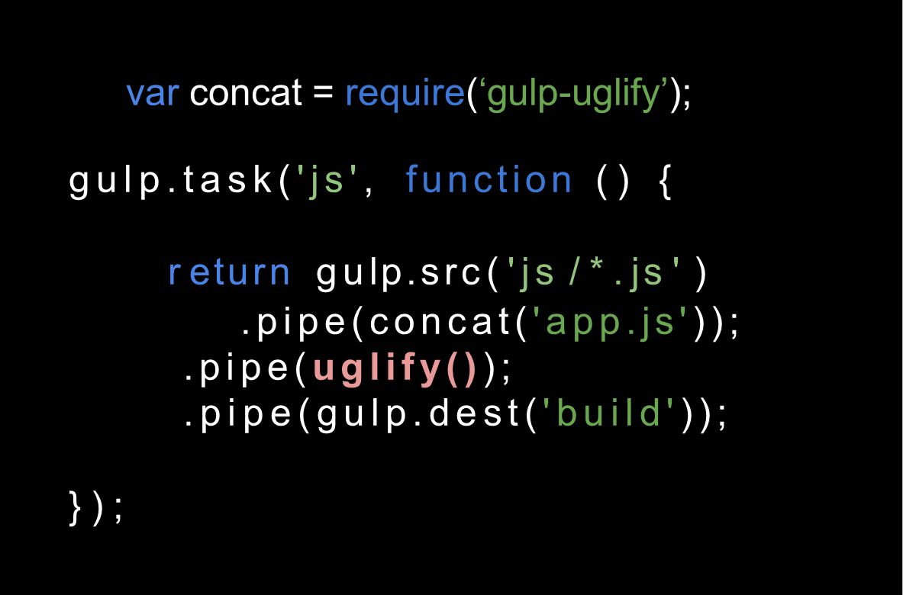
Uglify
Uglify is a JavaScript file minifier. It compresses the file size by removing all the spaces and new lines- which makes the code unreadable hence ugly. Uglify also joins sentences using comma, changes property access to dot notation (to reduce number of characters), removes dead code and removes console logs. It also simplifies conditional statements (if), Boolean operations, constants, function declarations etc.
To install Uglify:
> npm install --save-dev gulp-uglify
Then enter the codes for the task implementation

Slide 23
BrowserSync
var browserSync= require(‘browser-sync’);
gulp.task('js-watch', ['js'],browserSync.reload);
gulp.task('serve', ['js'], function () {
browserSync({
server: {
baseDir: "./src/"
},
port: 8080
});
// add browserSync.reload to the tasks array to make
// all browsers reload after tasks are complete.
gulp.watch("js/*.js", ['js-watch']);
});
BrowserSync is an automation tool that makes web development faster. In the past they’ve automated a lot of actions like compilation of SASS files, image compression etc.
To install BrowserSync:
> npm install --save-dev browser-sync
Then enter the codes below for the task implementation.

Slide 24
Other Plugins
imagemin
gulp-coffee/sass/less
livereload
gulp-util
compress/decompress
gulp-baseimg
gulp-beautify
gulp-clip-empty-files
gulp-cssdepth-check
(You can find more plugins at http://gulpjs.com)

Slide 25
References
http://gulpjs.com
http://nodejs.org
http://www.smashingmagazine.com/2014/06/11/building-with-gulp/
http://www.browsersync.io/docs/gulp/
https://www.npmjs.com/search?q=gulp
https://github.com/yeoman/generator-gulp-webapp
https://scotch.io/tutorials/how-to-use-browsersync-for-faster-development
https://www.computerhope.com/jargon/c/concaten.htm
https://www.npmjs.com/search?q=gulp-uglify
https://www.tutorialspoint.com/gulp/gulp_watch.htm
http://brandonclapp.com/what-is-gulp-js-and-why-use-it/
https://webdesign.tutsplus.com/tutorials/what-is-gulp--cms-30432
https://en.wikipedia.org/wiki/Grunt_(software)
https://code.tutsplus.com/tutorials/meet-grunt-the-build-tool-for-javascript--net-24856

Slide 26
Thanks for Listening
Presentation by: Reginn Lloyd Singgo

